Slide 1

DESKTOP PERSONAL ASSISTANT
MASTER OF COMPUTER APPLICATION
BY
Krishna Singh, Md. Gulsher Alam
Singh Yogesh Kumar Vijay Kumar
Under the esteemed guidance of
Mr. Hirdesh Sharma(Assis. Prof.)

Slide 2
INTRODUCTION
This project is based on windows system and provide personal assistant using voice recognition. This program includes the functions and services of: Music player service, checking weather, Google searching engine, Wikipedia searching engine.
This project is originated from a popular application from Windows called “Cortana”. This is very interesting, easy going and convenient, with wide real world usage and large developing potential. For instance, the voice assistance is very useful for personal assistants, direction guides or driving, helps among the disabled community, and so on.
This system is designed to be used efficiently on desktops. Personal assistant software improves user productivity by managing routine tasks of the user and by providing information from online sources to the user.

Slide 3
OBJECTIVE
Save your time.
Voice is reputed to be four times faster than a written search.
Fetch data from different API.
Automate the work.
Hand-free Operation.

Slide 4
PURPOSE
Being capable of voice interaction.
In this ever-evolving digital world where speed, efficiency, and convenience are constantly being optimized, it’s clear that we are moving towards less screen interaction.

Slide 5
SOFTWARE REQUIREMENT
Windows 7(32-bit) or above.
Python 2.7 or later.
Chrome Driver.
Any Text Editor.

Slide 6
HARDWARE REQUIREMENT
Pentium-pro processor or later.
RAM 512MB or more.
MIC(Working condition).
Speaker.

Slide 7
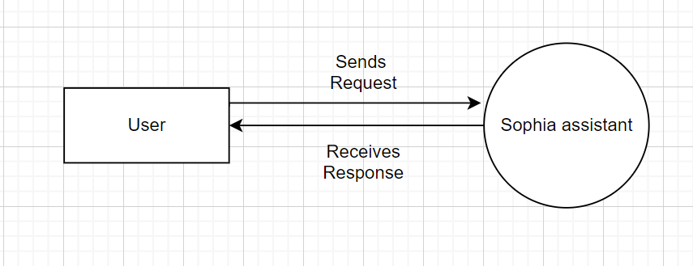
Data Flow Diagram
0 level

Slide 8
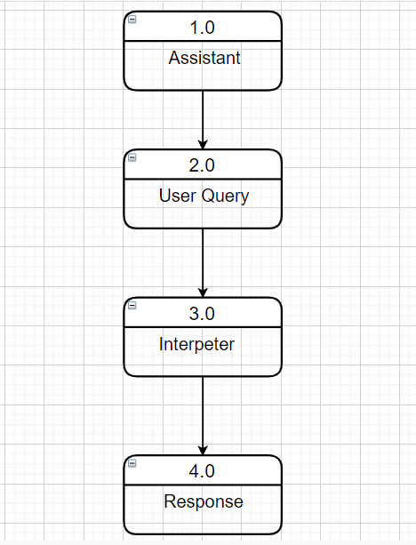
Data Flow Diagram
Level 1

Slide 9
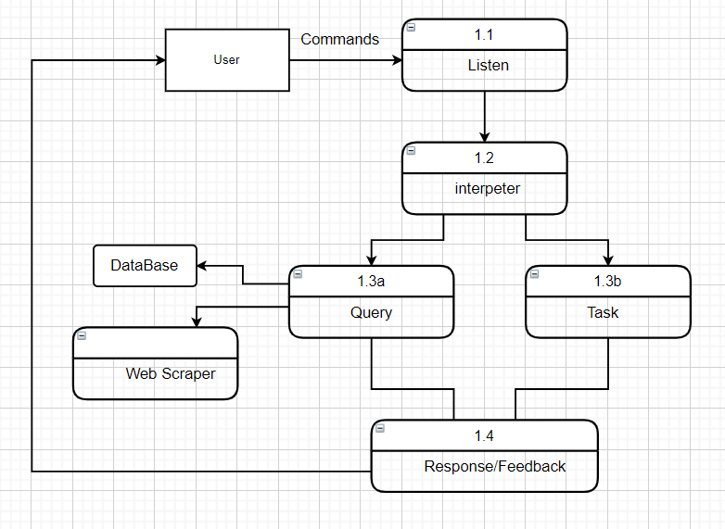
Data Flow Diagram
Level 2

Slide 10
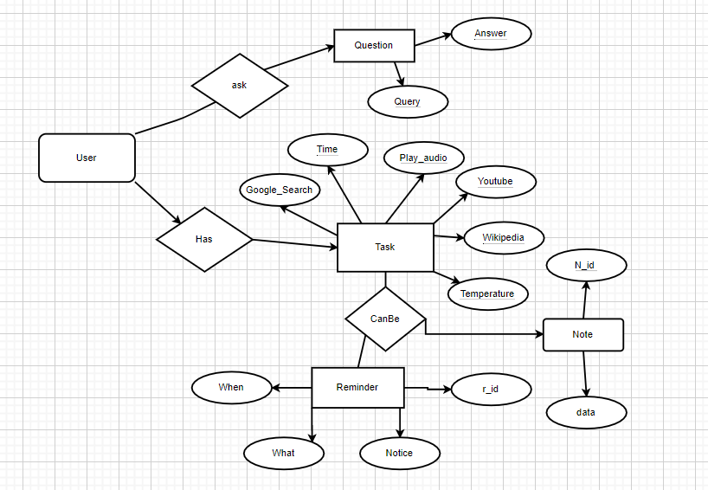
ER DIAGRAM

Slide 11
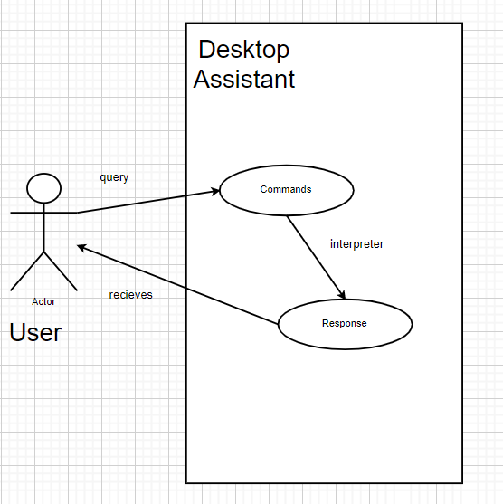
Class Diagram

Slide 12
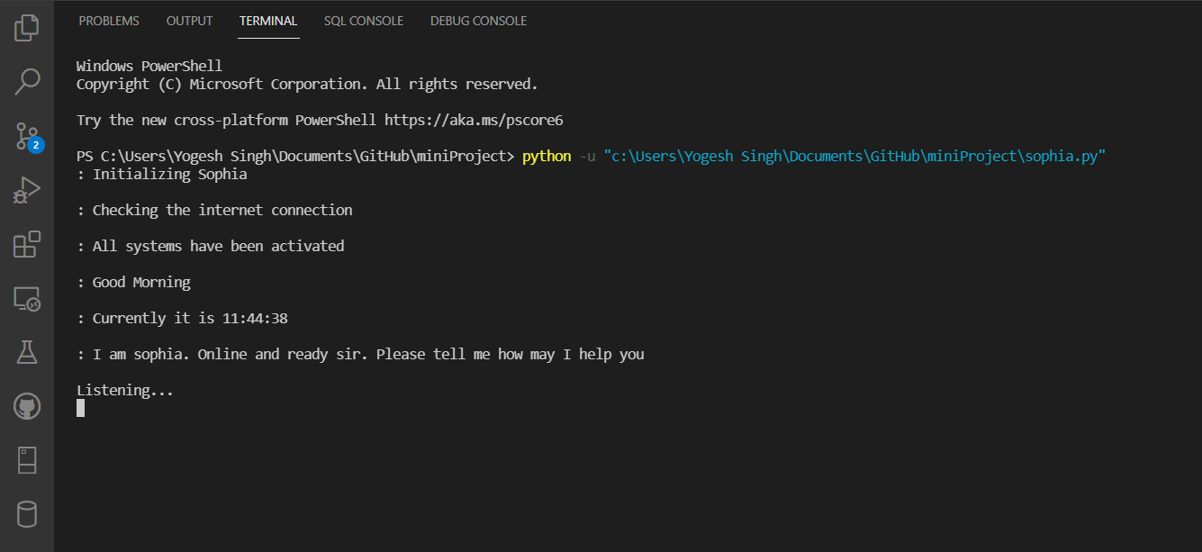
ScreenShot

Slide 13
Future Work
Design Improvements: No program has a perfect design without any user interface it is the same here in this program. Even though the program is completed with all the primary functions implemented and work properly. For now it is console based project.
Additional Functions: There can be more functions which simplify our daily life and make it convenient to use. Functions as playing movies, checking stocks, exchange rate, downloading video from YouTube and uploading, automate WhatsApp, send messages on email etc.
Voice Recognition: Give the all the secret information about user. Then it recognize voice the say accordingly. More Voice: Adding more voice option to communicate. Translation: Translate into any language.

Slide 14
Conclusions
An excellent virtual assistant will save time and money by doing the small tasks for you and doing them accurately and with high quality. If we handle the virtual assistant correctly, it will be a boom in your daily life.

Slide 15
THANK YOU!

